Slide 1
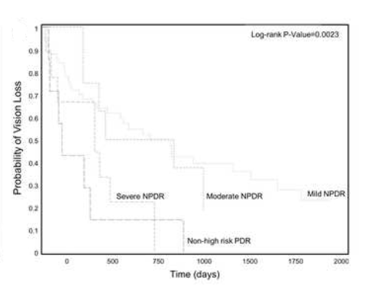

Natural History and Predictors of Vision Loss in Eyes with Diabetic Macular Edema and Good Initial Visual Acuity
Results
Introduction
126 eyes had DME with good baseline VA.
75% of eyes underwent visual acuity loss over a period of ~4 years (20/22 → 20/27)
Older age and severity of diabetic retinopathy were associated with vision loss.
No OCT biomarkers were associated with vision loss.
Ocular complications of diabetes mellitus are the leading cause of blindness and diabetic macular edema (DME) is one the main cause of central vision loss in diabetic patients.
KieuYen Luu
University of California, Davis School of Medicine
Hypothesis
There will be anatomic and clinical factors in patients with DME and good visual acuity (VA) that are associated with increased vision loss over time.
Main Finding:
In a sample of 126 eyes with DME and good baseline VA, older age and severity of diabetic retinopathy were associated with more rapid vision loss.
Interestingly, no anatomical biomarkers on OCT were associated with vision loss over time.
Methods
2262 medical records reviewed for patients diagnosed with DME + VA ≥ 20/25
Baseline and clinical characteristics (age, sex, severity of diabetic retinopathy, etc) were recorded
HbA1C levels and VA recorded annually.
Optical coherence tomography (OCT) images were graded for anatomic markers.
Discussion
Our results were consistent to protocol V, a large prospective study with similar research parameters
Hypothesize that our cohort study was not sensitive enough to identify a predicting imaging biomarker.

